Slide 1
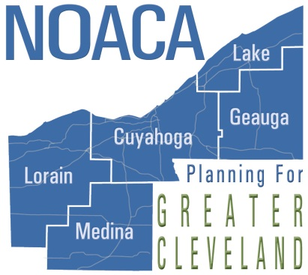
Rocky River Drive Plan
Northeast Ohio Areawide Coordinating Agency
Kamm’s Corners Development Corporation

Slide 2
Rocky River Drive Plan Goals
Identify transportation improvements for motorists, pedestrians, transit riders, and cyclists
Improve gateways to the neighborhood and connections to Cleveland Hopkins, Rocky River Reservation
Update 2002 Master Plan to reflect trends in property values, foreclosures, vacancy in order to develop a redevelopment strategy
Analyze options for City owned parking at Albers and West 168th Street

Slide 3
Timeline
2014 Deliverables | Completion
Outline project goals and objectives, | May 2014
Identify Steering Committee members | June 2014
Steering Committee Meeting #1 | June 2014
Existing Conditions Summary | September 2014
Community Meeting #1 | September 2014
Draft list of recommendations | November 2014
2015 Deliverables | Completion
Steering Committee Meeting #2 | January 2015
Draft prioritized implementation plan | March 2015
Community Meeting #2 | March 2015
Finalize list of recommendations | April 2015
Develop draft report | May 2015
Steering Committee Meeting #3 | May 2015
Finalize prioritized implementation plan | June 2015
Final report | June 2015
City Council and Planning Commission adoption | June 2015

Slide 4
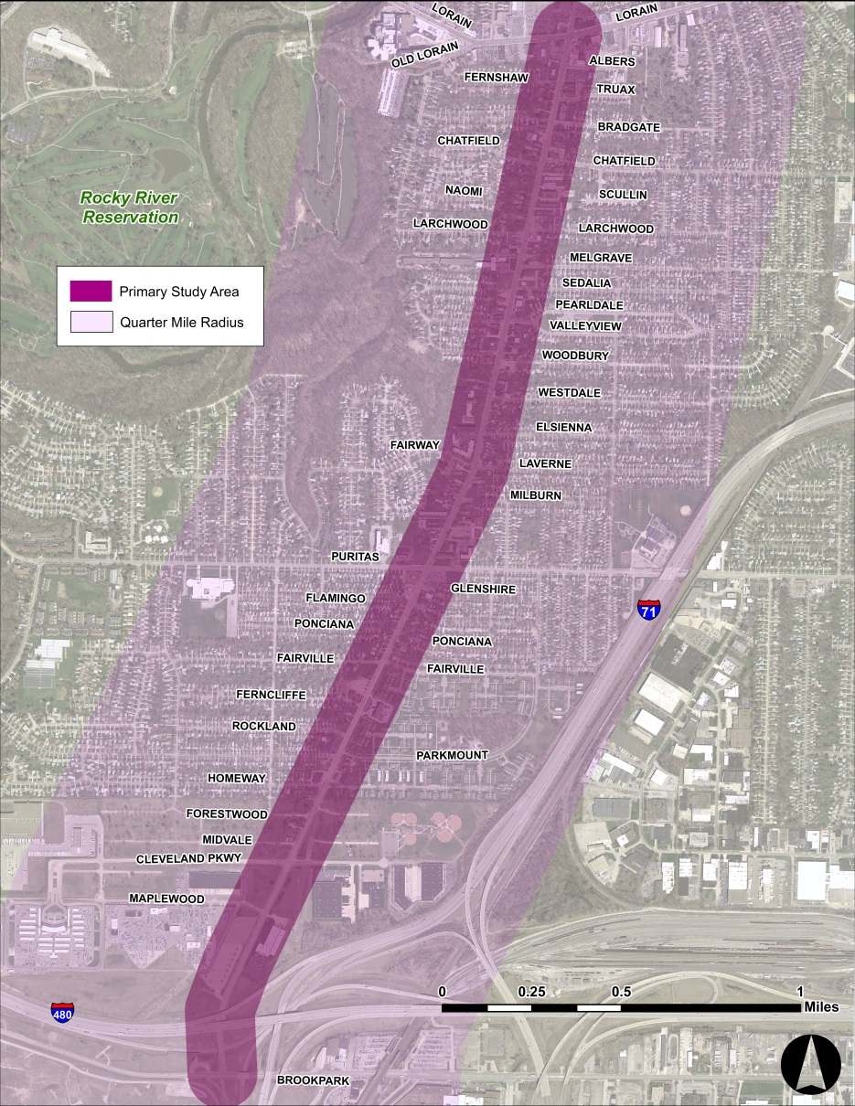
Study Area
2002 Master Plan
Current Study

Slide 5
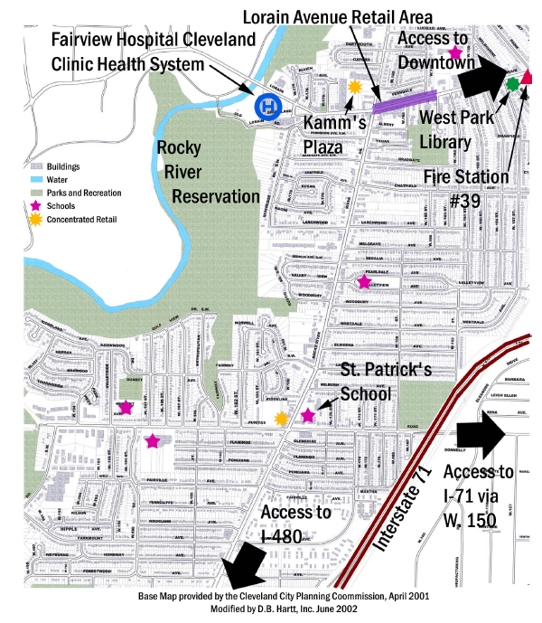
Community Amenities and Destinations
Identified in 2002 Master Plan
Since 2002, neighborhood assets have strengthened
Cleveland Clinic
Kamm’s Corners
St. Patrick’s Church
Rocky River Reservation

Slide 6
Population and Housing Trends
Overall, population is declining
Slowing between 2000 – 2010
Growth in young adults and adults
Age Characteristics 1980 - 2010
 | Under Age 18 | 18 to 24 | 25 to 44 | 45 to 64 | 65+ | Total
1980 | 5,534 | 2,364 | 5,085 | 4,030 | 2,439 | 19,452
Percent of Total | 28% | 12% | 26% | 21% | 13% | 100%
1990 | 4,219 | 1,305 | 5,583 | 3,320 | 2,615 | 17,042
Percent of Total | 25% | 8% | 33% | 19% | 15% | 100%
2000 | 3,546 | 972 | 4,960 | 3,074 | 2,318 | 14,870
Percent of Total | 24% | 7% | 33% | 21% | 16% | 100%
2010 | 3,200 | 1,236 | 4,022 | 3,932 | 1,668 | 14,058
Percent of Total | 23% | 9% | 29% | 28% | 12% | 100%
Population, Household, and Dwelling Units 1980 - 2010
 | Population | Households | Dwelling Units
2010 | 14,058 | 6,088 | 6,567
2000 | 14,870 | 6,347 | 6,558
1990 | 17,042 | 6,802 | 7,118
1980 | 19,452 | 6,758 | 6,913
Change 1980-2010 | -28% | -10% | -5%

Slide 7
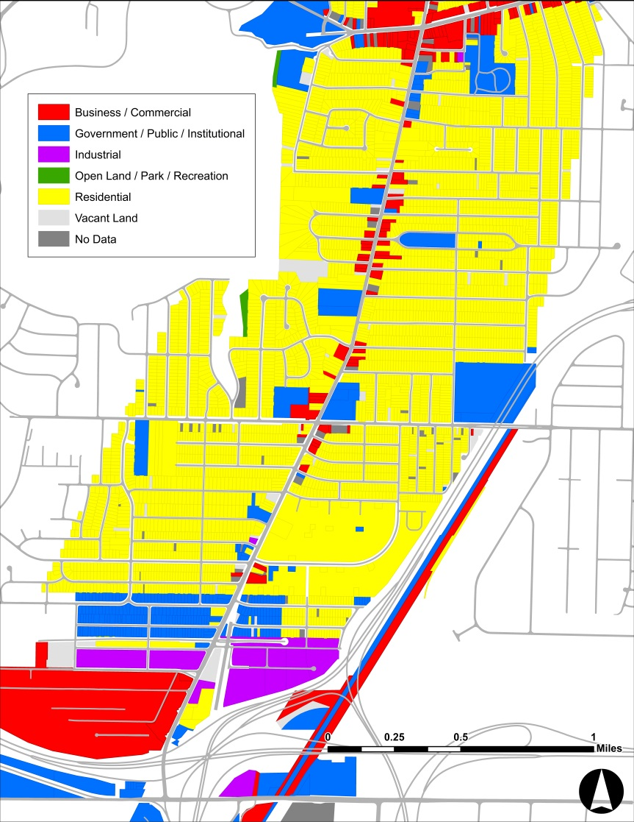
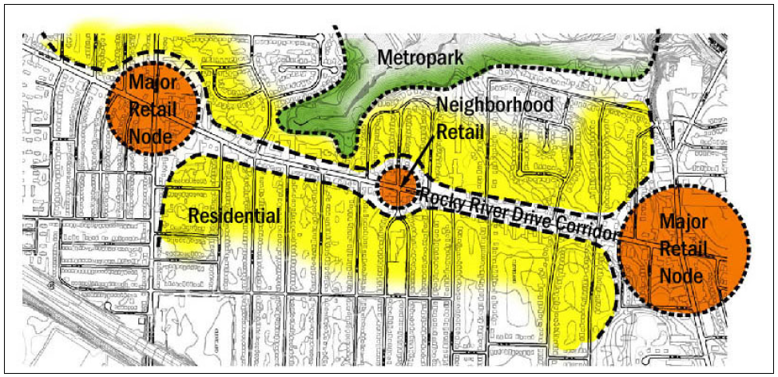
Property Characteristics
Land use has not significantly changed
Majority single family housing and apartments
Retail and commercial services located in nodes in some areas
Mixed with housing in others
2002 Master Plan

Slide 8
Property Values
4355 Properties total in study area (quarter mile radius)
Minimum: $0
Maximum: $87,719,100
Average: $79,720
Median Year Structure Built
Census Tract | Average
1236.01 | 1937
1236.02 | 1951
1236.03 | 1928
1237 | 1950
1238 | 1941

Slide 9
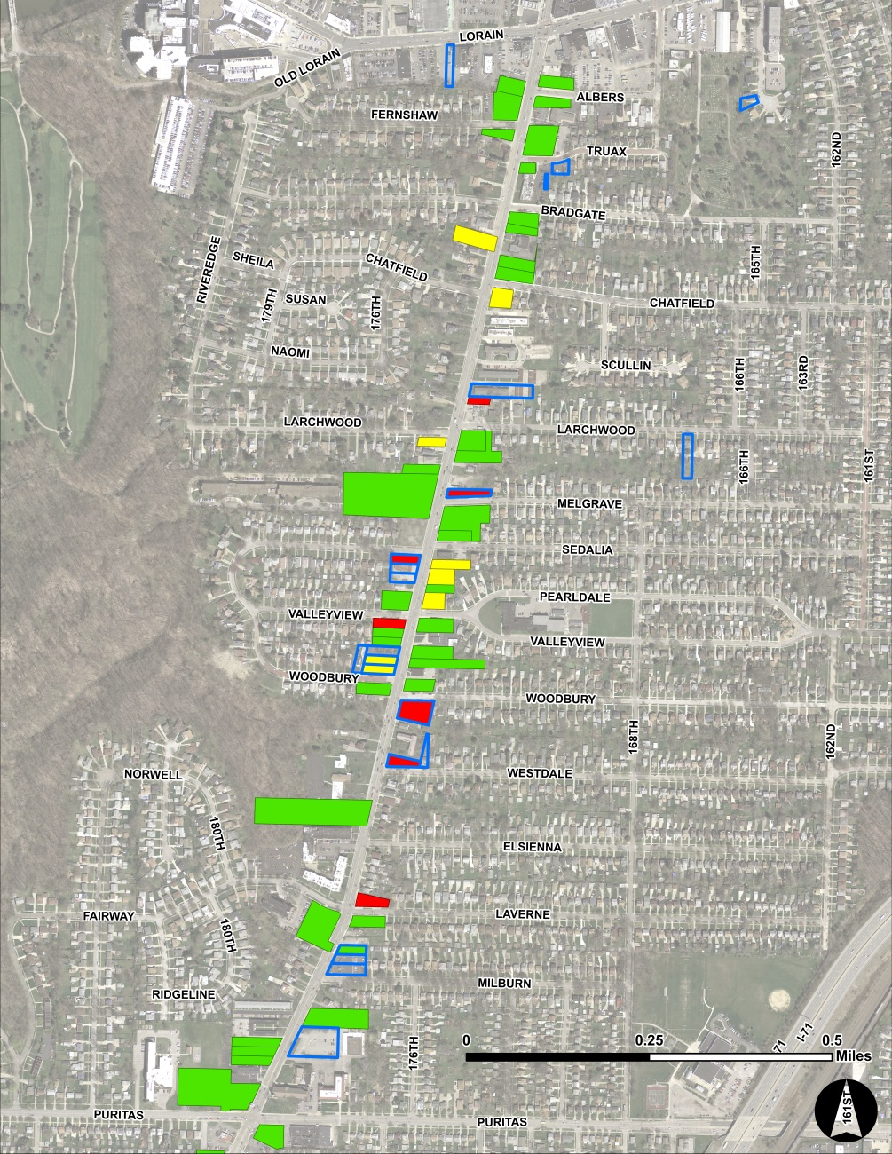
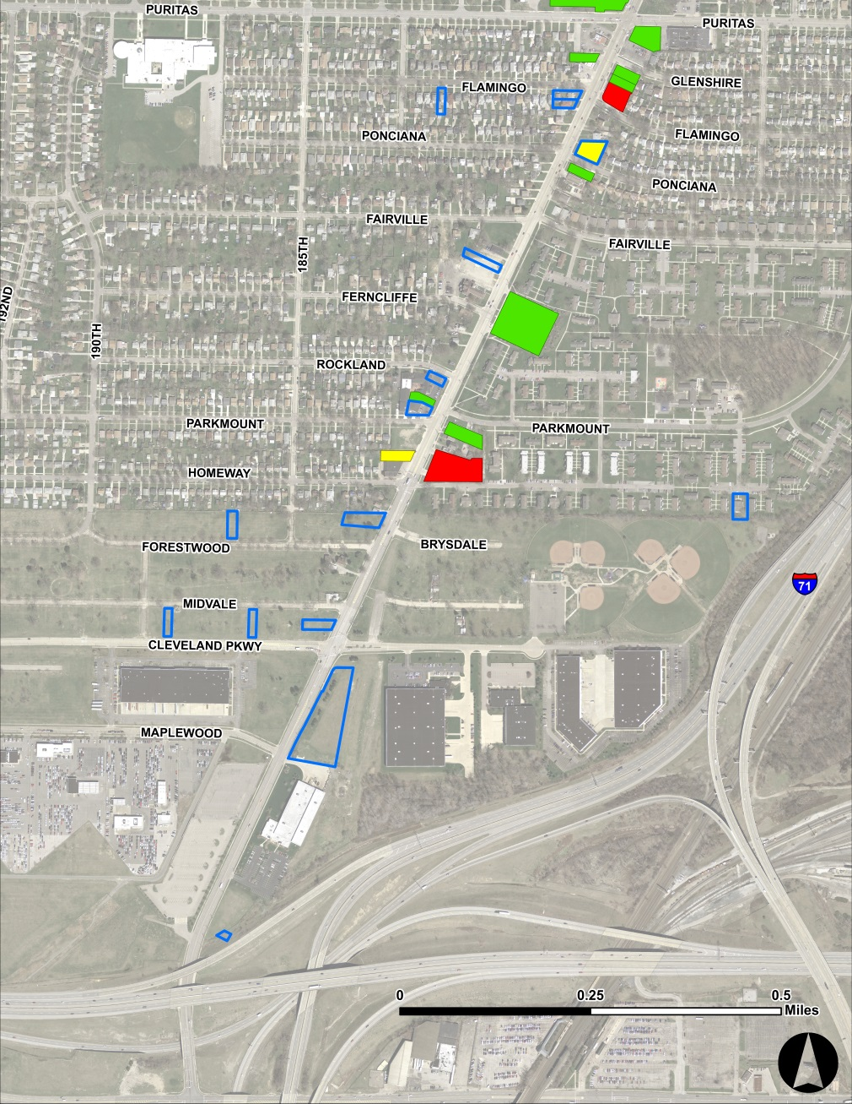
Building Conditions on Rocky River Drive

Slide 10
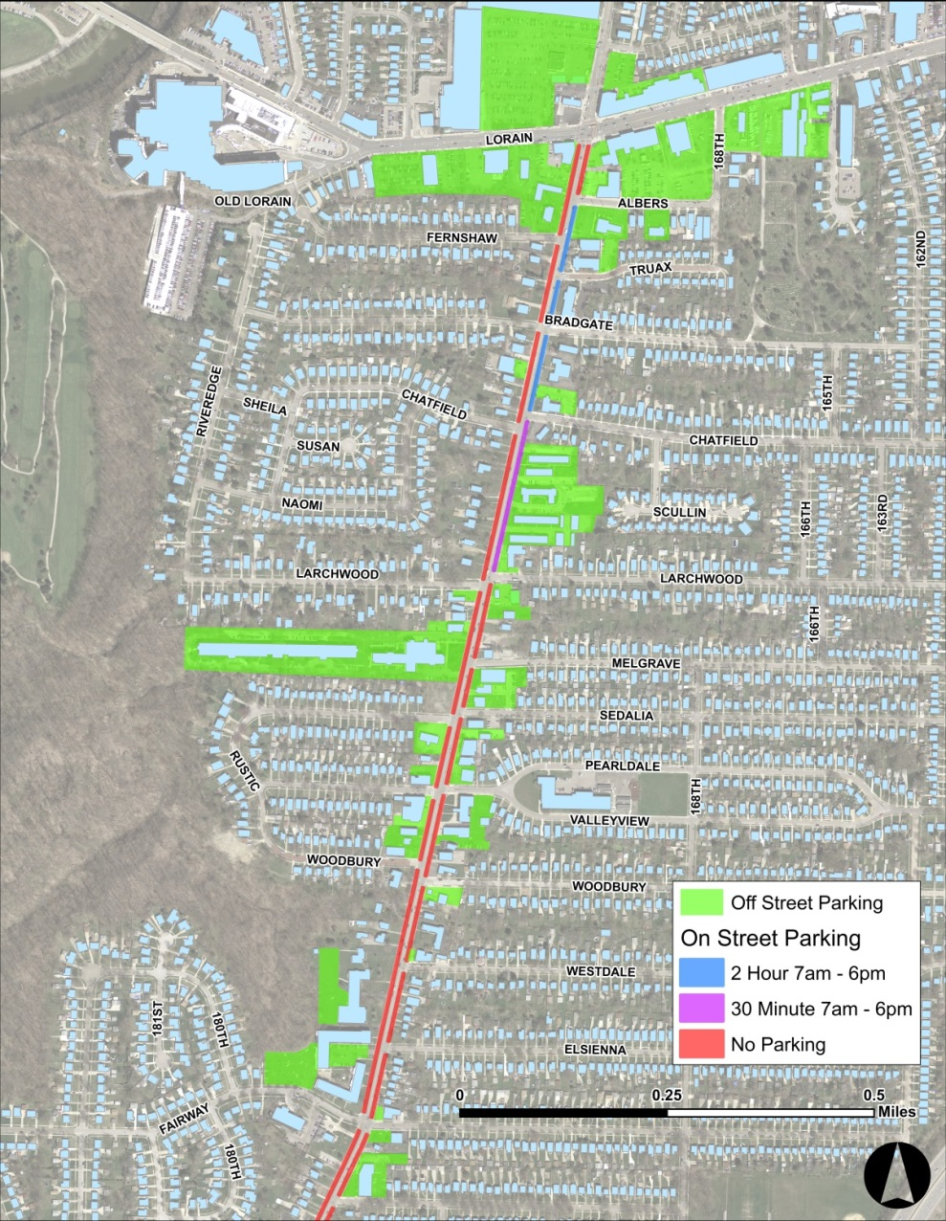
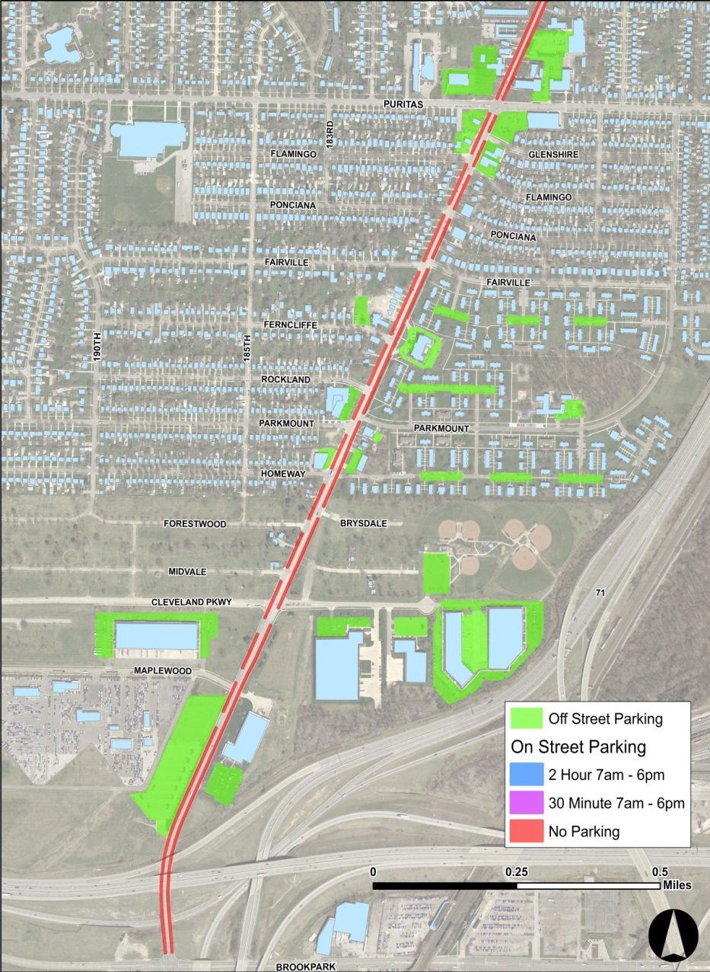
On and Off Street Parking

Slide 11
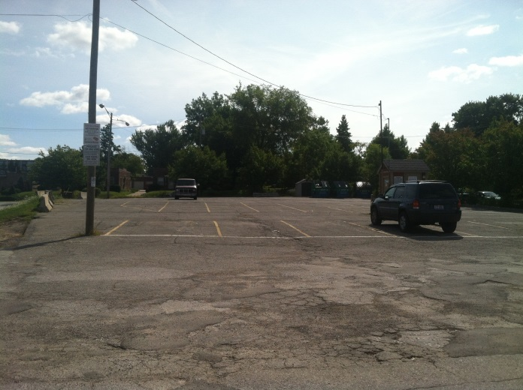
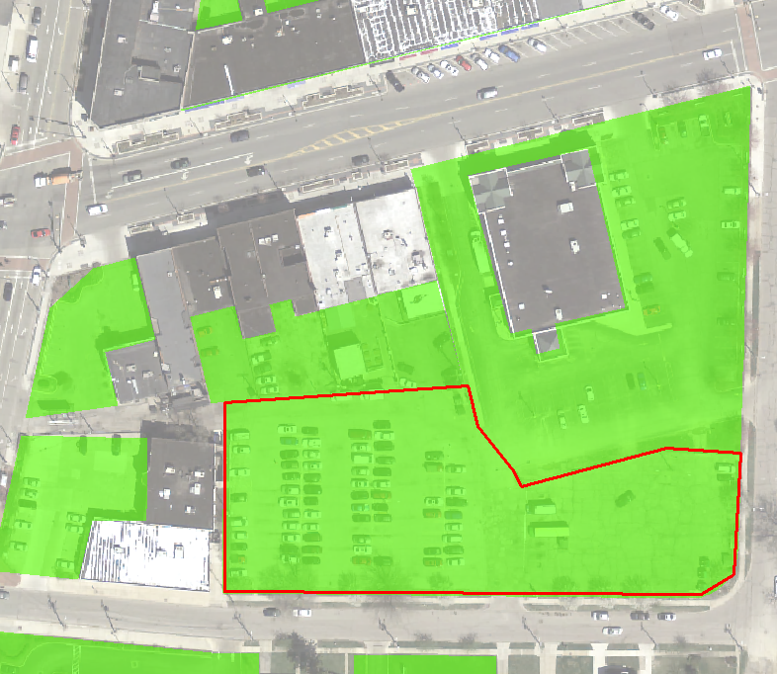
Albers Public Parking Lot
City owned lot behind Kamm’s Corners (southeast corner of Lorain and Rocky River Drive)
~145 spaces
In Kamm’s Corners parking is in high demand
In need of resurfacing and lighting
Needs maintenance and improvement plan
Site of special events, e.g. Kamm’s Corners Farmer’s Market

Slide 12
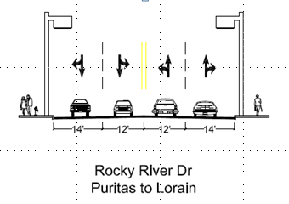
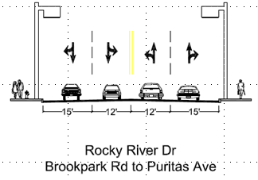
Street Sections and Lane Widths
Typical road width is 52 feet
Outer lanes widen south of Puritas
Average Daily Traffic around 16,000 vehicles
Higher volume closer to Lorain

Slide 13
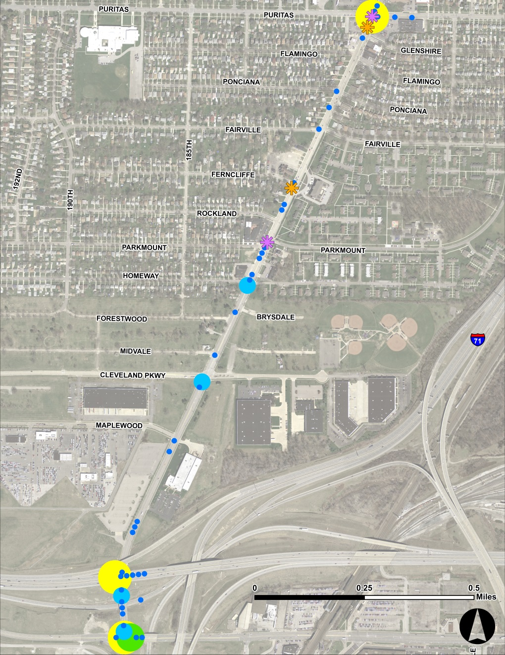
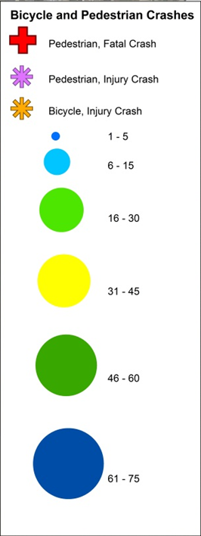
Crashes: Lorain to Puritas & Puritas to Brookpark

Slide 14
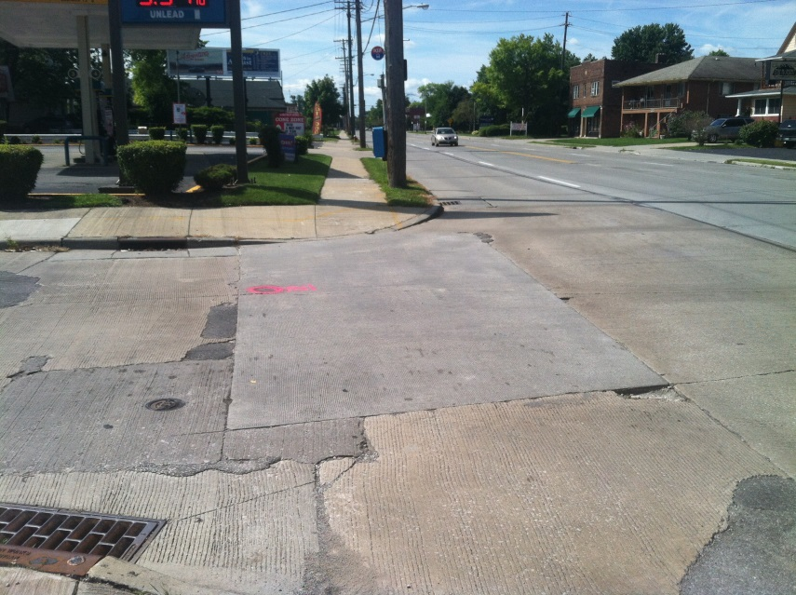
Sidewalks and Crosswalks
Sidewalk coverage is almost complete
Small sections missing on Cleveland Parkway
Condition is generally fair
Some utility poles and fire hydrants obstruct traffic
In areas curb is crumbling
Sediment, gravel, debris can pose hazard to pedestrians and cyclists
Curb ramps are not all ADA compliant
Crosswalk signals do not indicate “walk” without pushing button in places
In some places button does not work

Slide 15
Bicycle Infrastructure
Existing:
Metroparks Multiuse Path
Puritas Avenue Bike Lanes
Plans:
Puritas connector to Metroparks
Lorain Avenue east of W. 150th
Triskett Road (W. 140th to Lorain)
Proposed (by Cleveland Bikeway Implementation Plan)
Rocky River Drive
Connectors to Grayton Road and Cleveland Hopkins Airport

Slide 16
Public Transportation
Number 86 bus connects West Park and Brookpark Rapid Transit Stations, south to Berea
Weekdays: Departs once an hour (north and southbound) between 4:51 am and 10:37 pm
Weekends: Departs once an hour (north and southbound) between 5:38 am and 7:35 pm
Number 22 bus provides service to Cleveland Hopkins airport between 12:56 am and 3:56 am, when the Rapid is not running
Once an hour departure
Most stops are not sheltered in study area

Slide 17
Public Transportation
Ridership (# One Way Trips) | Route 78 | Route 86
2013 Annual Ridership | 412,512 | 151,685
Average Weekday Ridership | 1,612 | 572
Destination Type (% Trips on Average Weekday) | # 78 | # 86
Home | 44% | 51%
Work | 25% | 24%
Social Visit | 11% | 8%
School (K-12) | 6% | 1%
College-University | 3% | 5%
Doctor's Appointment | 3% | 0%
Shopping | 3% | 5%
Errand (bank, post office, etc.) | 2% | 0%
Recreation/Sightseeing | 1% | 5%
Restaurant | 1% | 0%
Other | 2% | 1%
Driver’s License | # 78 | # 86
Yes | 38% | 29%
No | 62% | 71%
Access Mode | # 78 | # 86
Walked | 63.6% | 47.2%
Biked | 0% | 0.3%
Dropped Off | 0.6% | 0%
Wheelchair/Scooter | 0.2% | 1.0%
Transferred from Red Line (W.117th) | 11.1% | -
Transferred from Red Line (Puritas) | 12.5% | -
Transferred from Red Line (West Park) | - | 19.1%
Transferred from Red Line (Brookpark) | 1.1% | 18.5%
Public Transit Usage (Days/Week) | # 78 | # 86
0 | 1% | 1%
1 | 3% | 5%
2 | 4% | 3%
3 | 9% | 5%
4 | 14% | 11%
5 | 37% | 52%
6 | 11% | 17%
7 | 22% | 8%

Slide 18
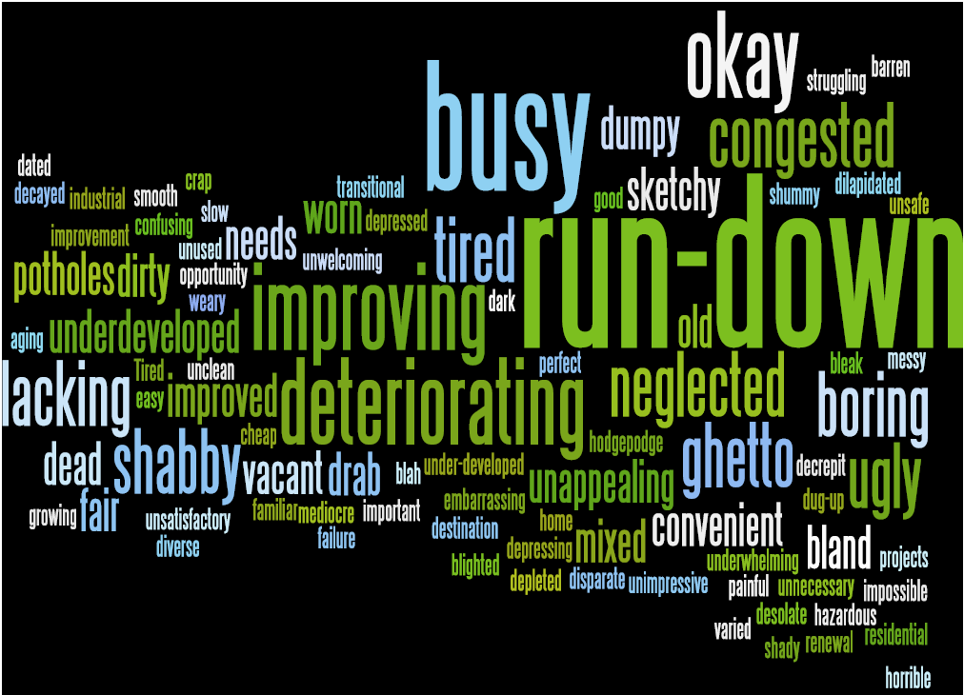
Community Feedback
One Word Impression:

Slide 19
Community Feedback

Slide 20
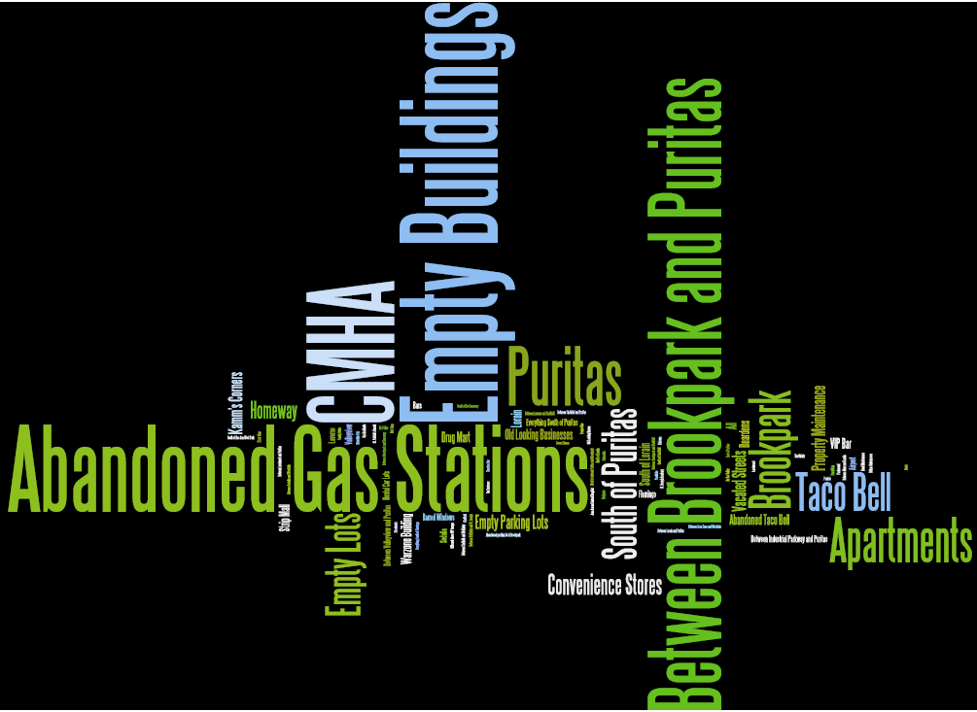
Community Feedback
Best Locations
Worst Locations

Slide 21
Community Feedback

Slide 22
Community Feedback

Slide 23
Community Feedback

Slide 24
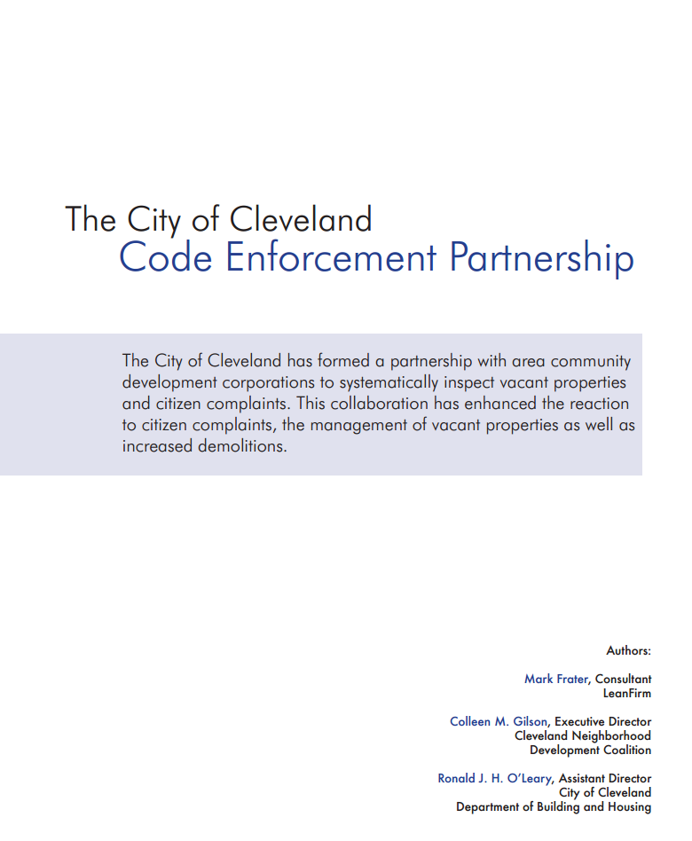
Preliminary Recommendations
Continue targeting commercial vacancies and abandoned homes for redevelopment or demolition
Identify strategies to attract new businesses and reduce vacancies
Encourage reinvestment to maintain and improve building stock
Encourage sideyard expansions where possible
Property upkeep and renewal
Address vacant properties for larger redevelopment projects
Explore opportunities for new senior housing
Promote efforts to upgrade the general appearance of the corridor
Consolidate utility poles
Limit signage to appropriate scale and design
Prohibit digital reader board signs
Discuss long term strategy of CMHA properties with authority

Slide 25
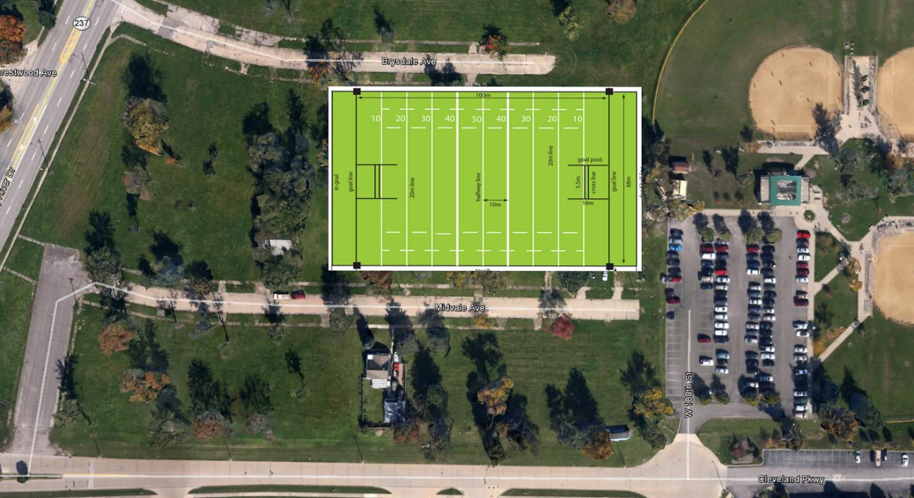
Preliminary Recommendations
Introduce more neighborhood greenspace
Determine development potential of vacated streets (Forestdale and Midvale) with Chelm properties
Based on negotiations, plan for passive and active recreation spaces, particularly adjacent to the Rocky River Drive Corridor
Short term: native plantings, low maintenance
Longer term strategy – identify recreational opportunites
Conceptualize a rugby facility, possibly near existing baseball fields

Slide 26
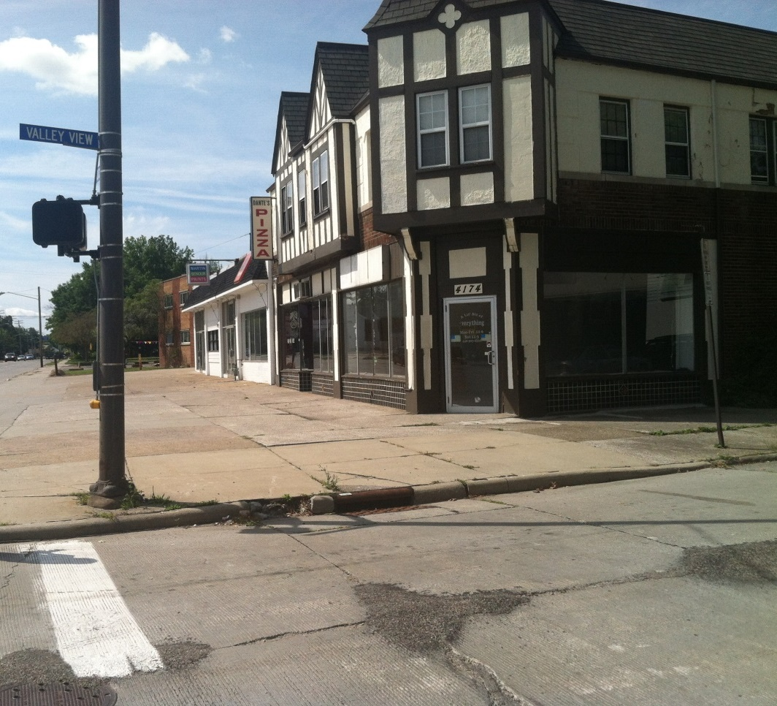
Preliminary Recommendations
Focus on mixed use nodes along Rocky River Drive
Stategically employ Urban Overlay zoning to promote mixed use/walkability
Cluster of commercial uses around Valleyview Drive (between Lorain and Puritas)
Intersection of Puritas and Rocky River Drive
Parkmount/Homeway and Rocky River Drive

Slide 27
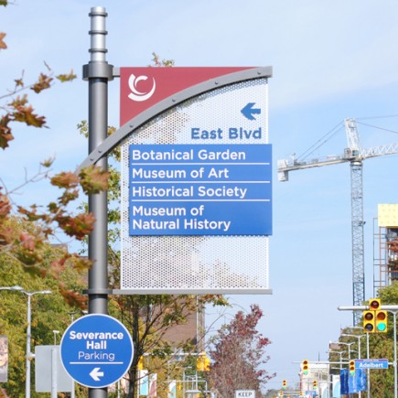
Preliminary Recommendations
Create neighborhood gateway on southern end of study area (consistent with wayfinding)
New Gas Station at Brookpark and Rocky River Drive
Will include gateway landscaping – signage to West Park, Kamm’s Corners
Cleveland Parkway
Denotes separation from airport uses (i.e., rental car facilities)
Extend wayfinding to Brookpark

Slide 28
Preliminary Recommendations
Albers Parking Lot
Resurface parking lot, asphalt is in bad condition
Restripe boundaries to delineate between lot area and adjacent travel lanes and private lots
Study feasibility of installing pay station for typical daily use, can be suspended for special events (i.e., Hooley). Downtown Lakewood, Cleveland Heights are good examples
Improve lighting for safety
Improve signage (consistent with wayfinding and neighborhood gateway)
Discuss management of lot by Kamm’s Corners with City of Cleveland
Long term:
Work with near-by property owners to identify separate lots to more efficiently use/share parking space
Identify measures to address grade change between Albers and Walgreens lots
Incorporate stormwater controls/green infrastructure to alleviate stormwater flooding and improve attractiveness/emulate landscaping on Lorain

Slide 29
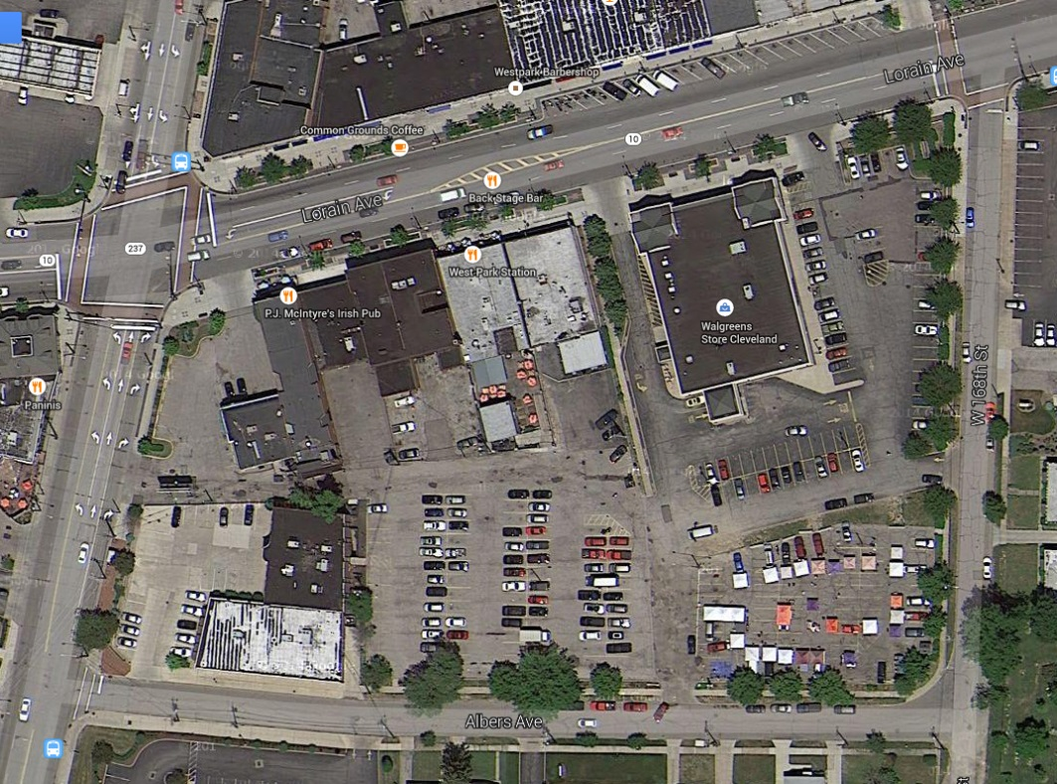
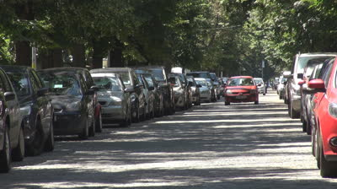
Preliminary Recommendations
Albers Ave.
Convert Albers Ave. to one-way operation (traffic flows east, enter on Rocky River, exit on West 168th)
Allow on-street parking on both sides of street

Slide 30
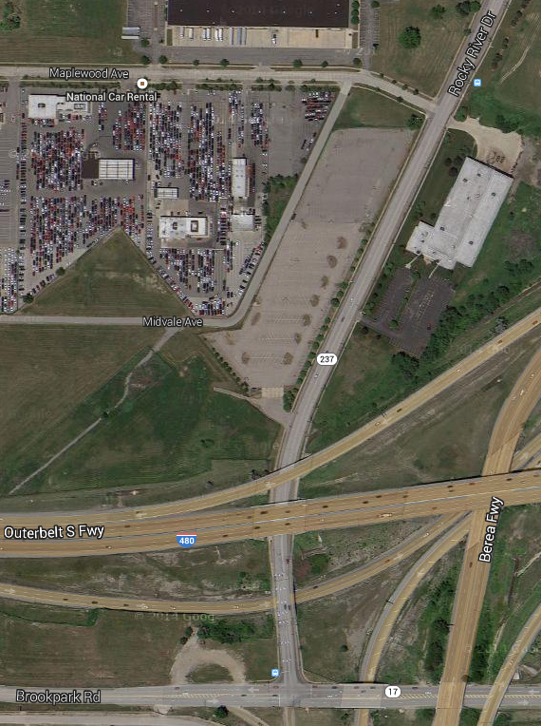
Preliminary Recommendations
Parking
Encourage new parking lots to be situated at the rear or side of structures by decreasing building setbacks along Rocky River Drive
Work with property owners to better utilize under capacity parking lots, either through landscaping or redevelopment
Study reuse options for parking lot south of Maplewood

Slide 31
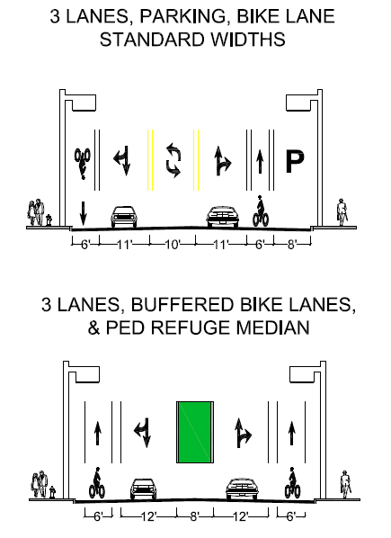
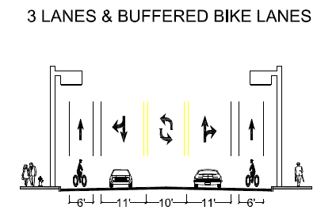
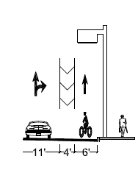
Proposed Traffic Operations: North of Puritas

Slide 32
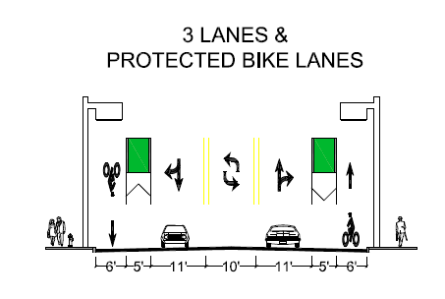
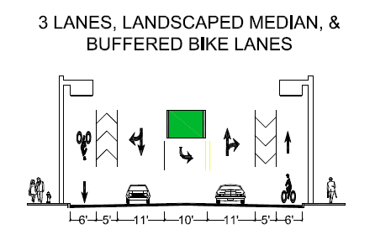
Proposed Traffic Operations: South of Puritas
(South of Homeway)

Slide 33
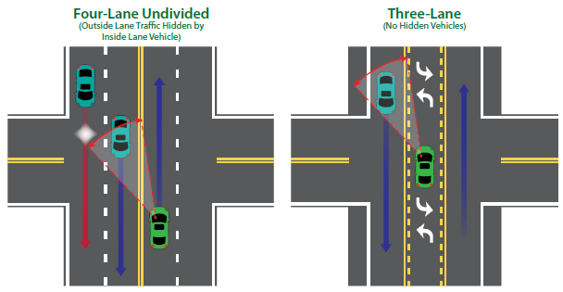
Benefits of 3-lane Roadway
SAFETY: 29% Reduction in crashes, improved visibility for left-turning cars & crossing pedestrians, reduced speeding
LIVABILITY: driving lanes are further away from sidewalk, median could be landscaped where turn lanes aren’t needed
OPERATIONS: separating left turns reduces delay, side street through movements are easier

Slide 34
Current Configuration

Slide 35
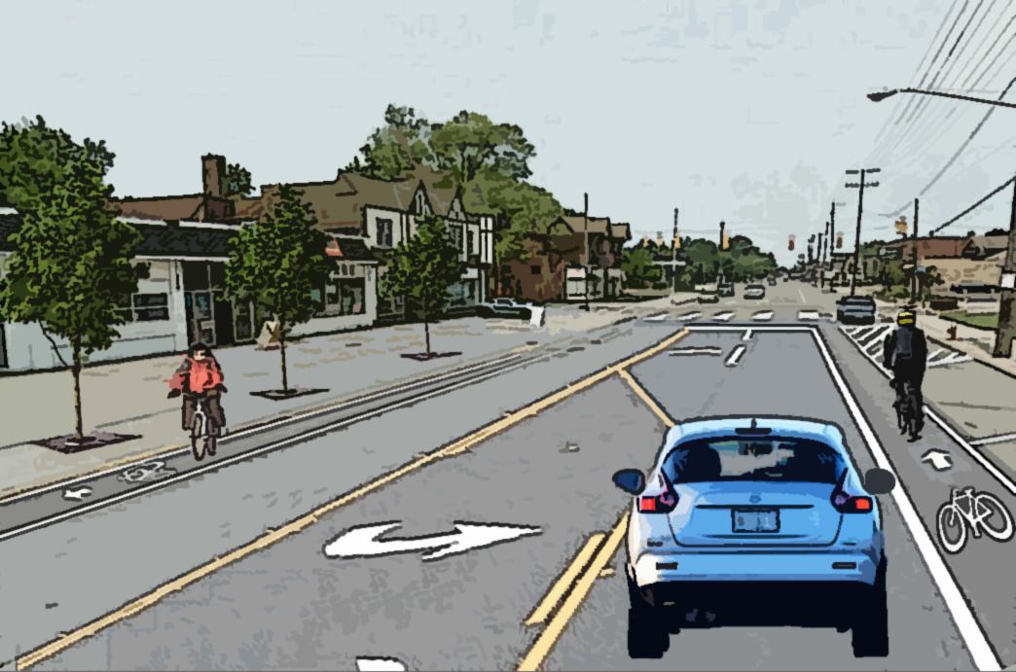
Proposed Configuration

Slide 36
Current Configuration

Slide 37
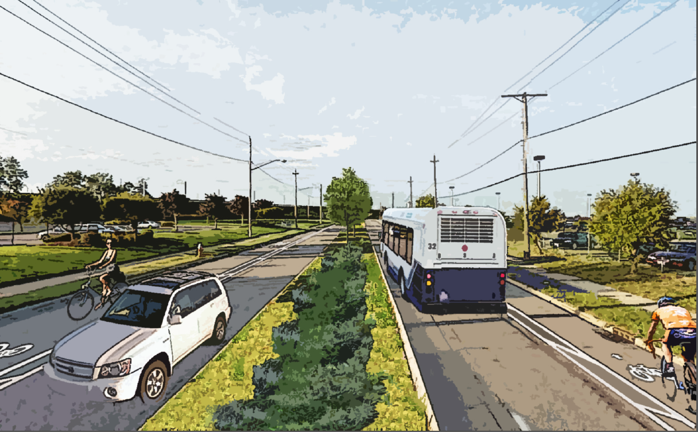
Proposed Configuration

Slide 38
Preliminary Recommendations
Sidewalks
Construct sidewalk from intersection of Brookpark Road and Rocky River Drive to Brookpark Rapid Transit Station (both entrances)
Address debris on sidewalk (trash, gravel, etc.)
Request City of Cleveland to regularly schedule street sweeping of Rocky River Drive
Spot repair cracked/deteriorated sidewalks through partnership with property owners and city sidewalk repair program
Light 480 underpass and repair chain link fence

Slide 39
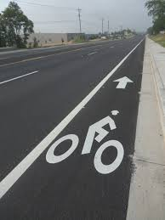
Preliminary Recommendations
Bicycle Infrastructure
Install bike lanes on Rocky River Drive (see street reconfiguration)
Continue bike lanes on Puritas though Rocky River Drive intersection west to Rocky River Drive Reservation entrance
Long term – explore multiuse path to connect to Metroparks facility
Work with business owners to install bike parking
Potential bike box on West 168th/alleyway
Explore multiuse path from Brookpark Road/Rocky River Drive intersection to Cleveland Hopkins International Airport with City of Cleveland Department of Port Control
Identify examples of airports with multiuse paths

Slide 40
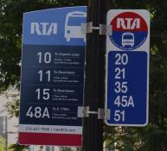
Preliminary Recommendations
Transit
Replace bus stop signs with new RTA bus stop signage, which includes route information
Consolidate bus stops where feasible
Consolidated stops could warrant new shelters
Ensure all bus stops have paved boarding areas
Discuss feasibility of #86 service stopping at Cleveland Hopkins International Airport

Slide 41
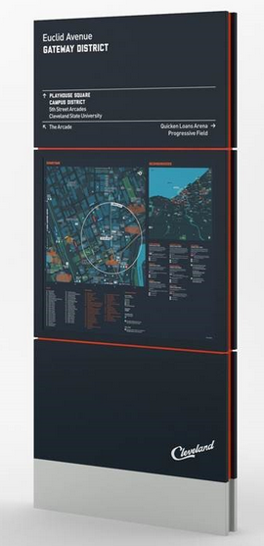
Preliminary Recommendations
Wayfinding
Develop wayfinding that helps to identify West Park neighborhood
Locate directionality to rapid transit stations, neighborhood centers, parks, parking
Streetscape
Identify where street trees can be planted/replaced
Enhance lighting on the corridor, particularly near Cleveland Parkway

Slide 42
Next Steps
Incorporate public comments
Finalize recommendations
Develop implementation plan and preliminary cost estimates
Stakeholder Meeting 3
Draft final report

Slide 43
Questions or Comments?
Ryan Noles rnoles@mpo.noaca.org or 216-241-2414 ext. 273
Ben Campbell ben.campbell@kammscorners.com or
216-252-6559 ext. 1200

